Slide 1

SQL
STAFF’S COPY
Here is where your journey for your dream begins

Slide 2
DAY 4
DATATYPES

Slide 3
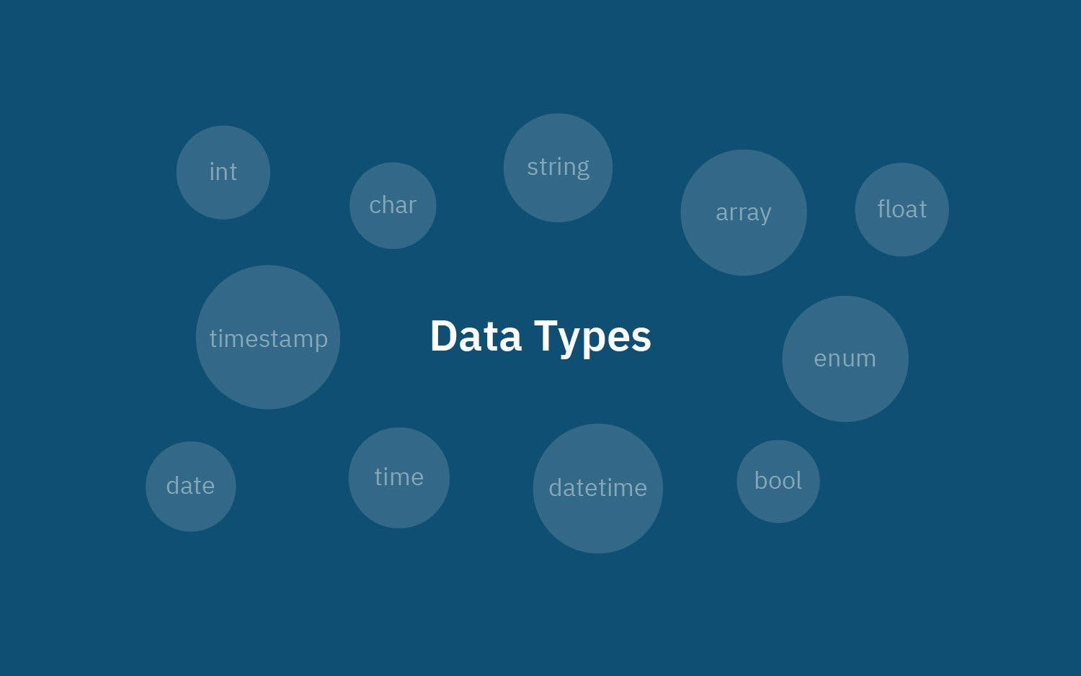
DATATYPES IN SQL
Datatype is used to specify or determine what type of data should be stored in a particular memory location.
A SQL developer must decide what type of data that will be stored in each column when creating a table.

Slide 4
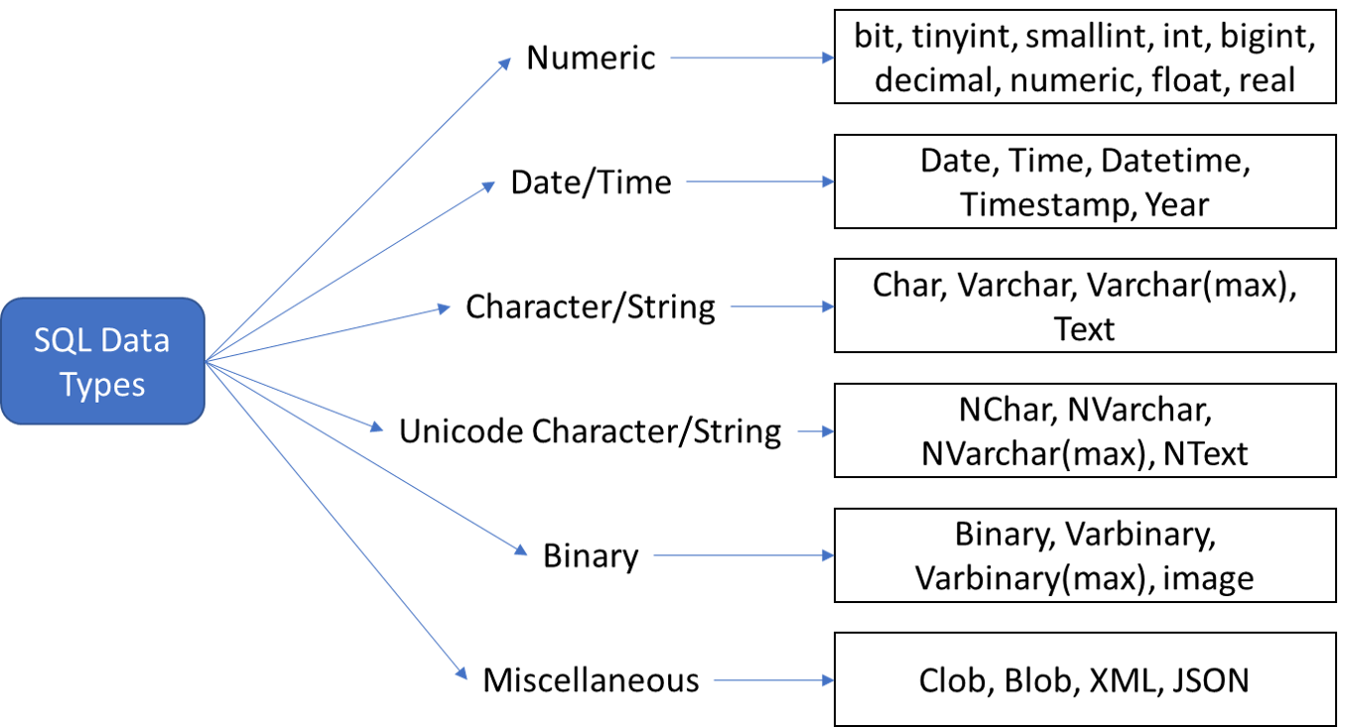

Slide 5
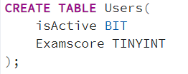
BIT
Returns a Boolean.
From | To
0 | 1
0 -> False
1 -> True
TINYINT
Occupies 1 Byte space in memory.
From | To
0 | 255
Contains Numeric values.

Slide 6
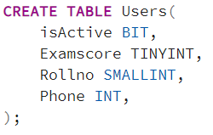
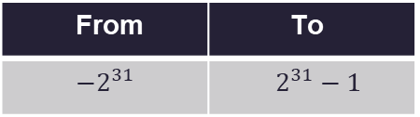
SMALLINT
Occupies 2 Bytes space in memory.
From | To
-32768 | 32767
Contains Numeric values.
INT
Occupies 4 Bytes space in memory.
From | To
$−2^{31}$ | $2^{31}−1$
Contains Numeric values.

Slide 7
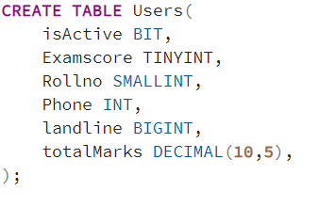
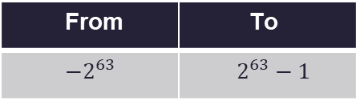
BIGINT
Occupies 8 Bytes space in memory.
From | To
$−2^{63}$ | $2^{63}−1$
Contains Numeric values.
DECIMAL(NUMERIC)
DECIMAL(Precision , [scale])
Precision is used to determine the number of digits used to store integer value
Precision | scale
10 - 65 | 0 - 30
Scale is used to determine the number of decimal digits within the precision (not mandatory, initial value is 0).

Slide 8
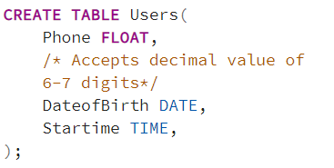
FLOAT
Occupies 4 Bytes space in memory.
Contains Decimal values (6-7 digits).
DATE
Stores the date on when the data is stored on the record.
Format ➔ YYYY-MM-DD
TIME
Stores the time on when the data is stored on the record.
Format ➔ hh-mm-ss

Slide 9
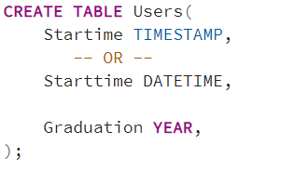
DATETIME(TIMESTAMP)
Stores both date and time of data when it is stored in the record.
Format ➔ YYYY-MM-DD hh-mm-ss
Can you the keyword Datetime or Timestamp.
YEAR
Stores the year in four digit format.
Format ➔ YYYY

Slide 10
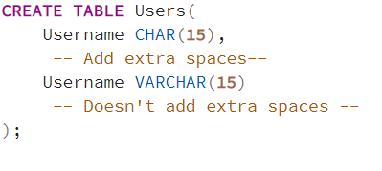
CHAR(SIZE)
Fixed length character string(up to 8000 characters).
All columns have same size.
Adds spaces to fill the gaps in data.
Ex :
for Name CHAR(10) → the size of the string should be 10 but if you provide string of size 8 it adds spaces and make the string size to 10.
VARCHAR(SIZE)
Variable length character string(up to 8000 characters).
All columns have different size based on the string.

Slide 11
VARCHAR(MAX)
Works with very large character string(up to 2GB).

Slide 13
Thanks!
Do you have any questions?
hive@hiveed.in
www.hiveed.in

